Slide 1
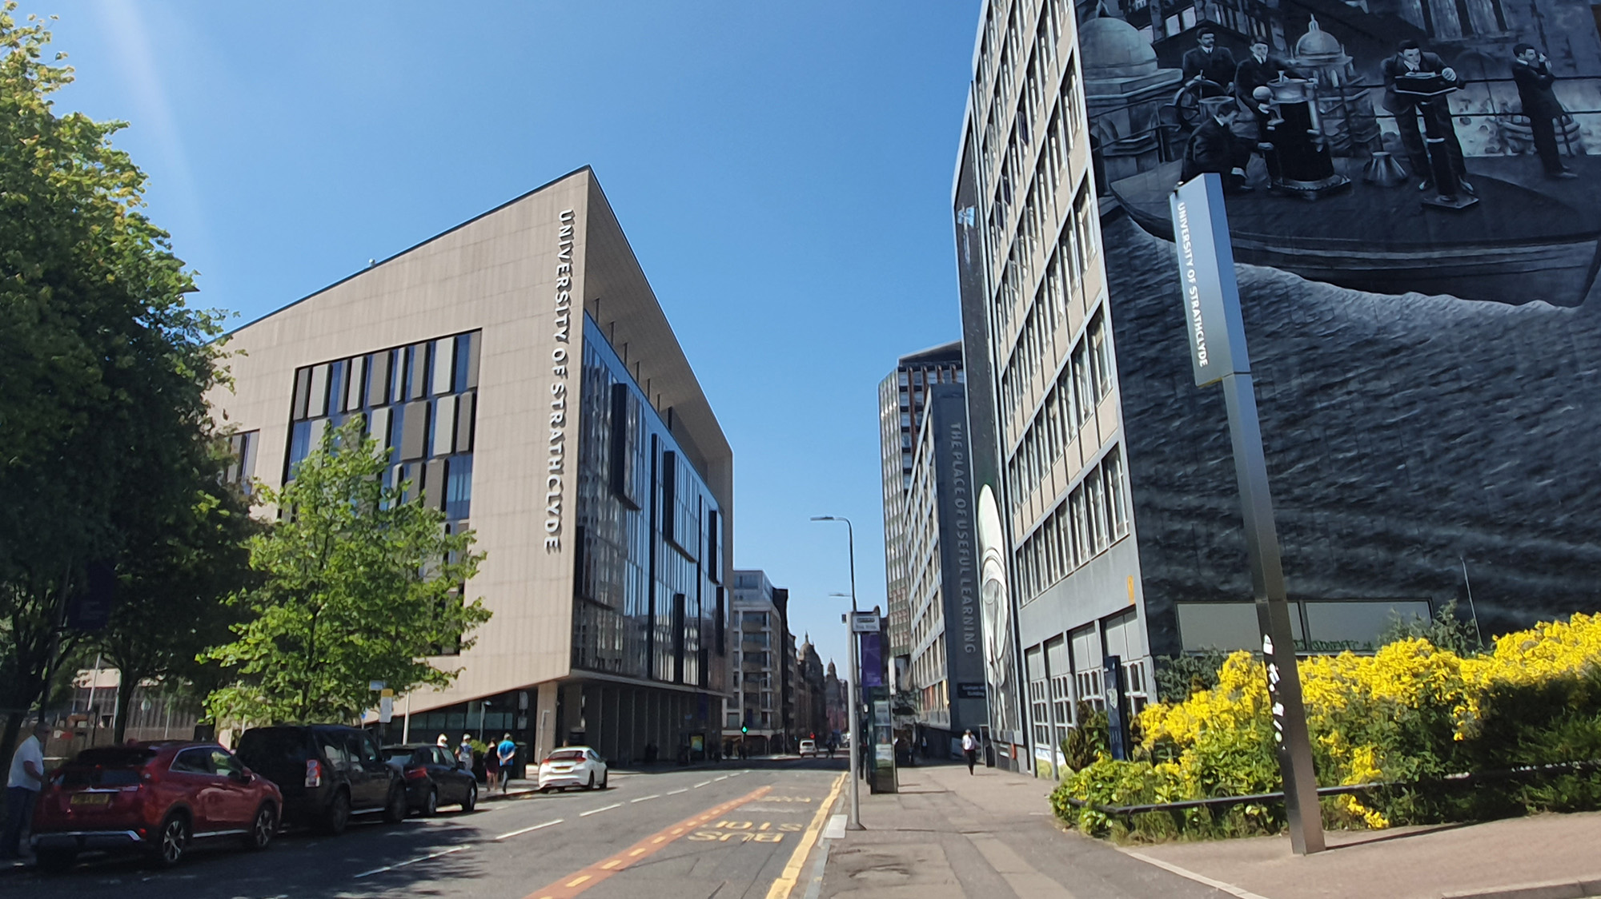

DSP Principles 2022/2023
Semester 2
EE469/EE669/EE969
Module Introduction
carmine.clemente@strath.ac.uk

Slide 2
DSP Applications
Discrete Cosine Transform (DCT) for Signal Compression (Data Reduction): Core to Efficient Signal Transmission and Storage and the basis of Jpeg, MPEG, MP3 . Furthermore is of particular use in Machine Learning/Deep Learning as a means of reducing the dimension of the data input to a Deep Learning Architecture.
Time Frequency Analysis and its application to analyse time-varying signals. In semester 1 the lectures considered stationary (time invariant) signals. The STFT will be used for processing Speech and Radar Signals in the Matlab tasks.
Principles of Speech Processing: as an example of application domain of DSP the case of human speech processing and analysis will be introduced. Speech processing is a mature application of DSP that we can find nowadays in everyone house (Alexa, Google assistant).
Principles of Radar Signal Processing: Radar is taken as example of a sensor in which DSP plays a fundamental role from the design to the application. After introducing some fundamental concepts of Radar sensing a DSP challenge based approach will demonstrate how DSP is important to the area of information extraction from sensed signals.

Slide 3
Semester 2 Assessment
Week 9- In-class test as in Semester 1.
Laboratory - Matlab tasks as in Semester 1 – Released in weeks 2, 4 and 6;
DSP Topic (CA5) (for EE969 only):
In week 3 a list of DSP Application Topics will be posted on Myplace and EE969 students will be requested to select a choice of topics or their own topic. The allocation of a single topic will be made in week 4.
Each student selects a DSP topic and is asked to produce a short video presentation (10 minutes) about the topic;
Additionally, each student is asked to watch 2 other videos (assigned randomly) and to engage via a forum with the author in an asynchronous Q&A session.
Submission at the end of Semester 2

Slide 4
Semester 2 – KEY submission Dates
Semester 2 Test: Friday Week 9 (TBC)
Matlab Tasks: Friday week 11 at 5 pm.
DSP topic – EE969 only: Topic List Released on Monday Week 3, selected topics to be returned by Friday week 3, Week 4 topic assigned.
Submission Deadline Friday Week 9 at 5pm.
Discussion forum deadline Friday Week 11 at 5 pm.

Slide 5
Discrete Cosine Transform
Module Introduction
carmine.clemente@strath.ac.uk

Slide 6
DCT – Motivation
1D, 2D, … ND form of discrete information
Removes data redundancies
Adds Channel Tailored Redundancies
Source
Source Coding
Channel Coding
Transmission Channel
Reconstructed
Source
Source De-Coding
Channel De-Coding
Reconstructs original data
Removes Channel Tailored Redundancies
The Discrete Cosine Transform is one of the techniques that has become popular and widely used for source coding purposes, thanks to its capability to reduce redundancies in the data and easy computation.

Slide 7
DCT – Motivation
Correlated data require resources for storing or transmission that could be reduced if compression is applied.
Source 2D data
Normalized Autocorrelation
The DCT decorrelates the data in order to provide coefficients that can be encoded independently without losing compression efficiency.

Slide 8
DCT – 1D definition
The DCT of a 1D sequence of length N is:
Similarly the inverse DCT is defined as:

Slide 9
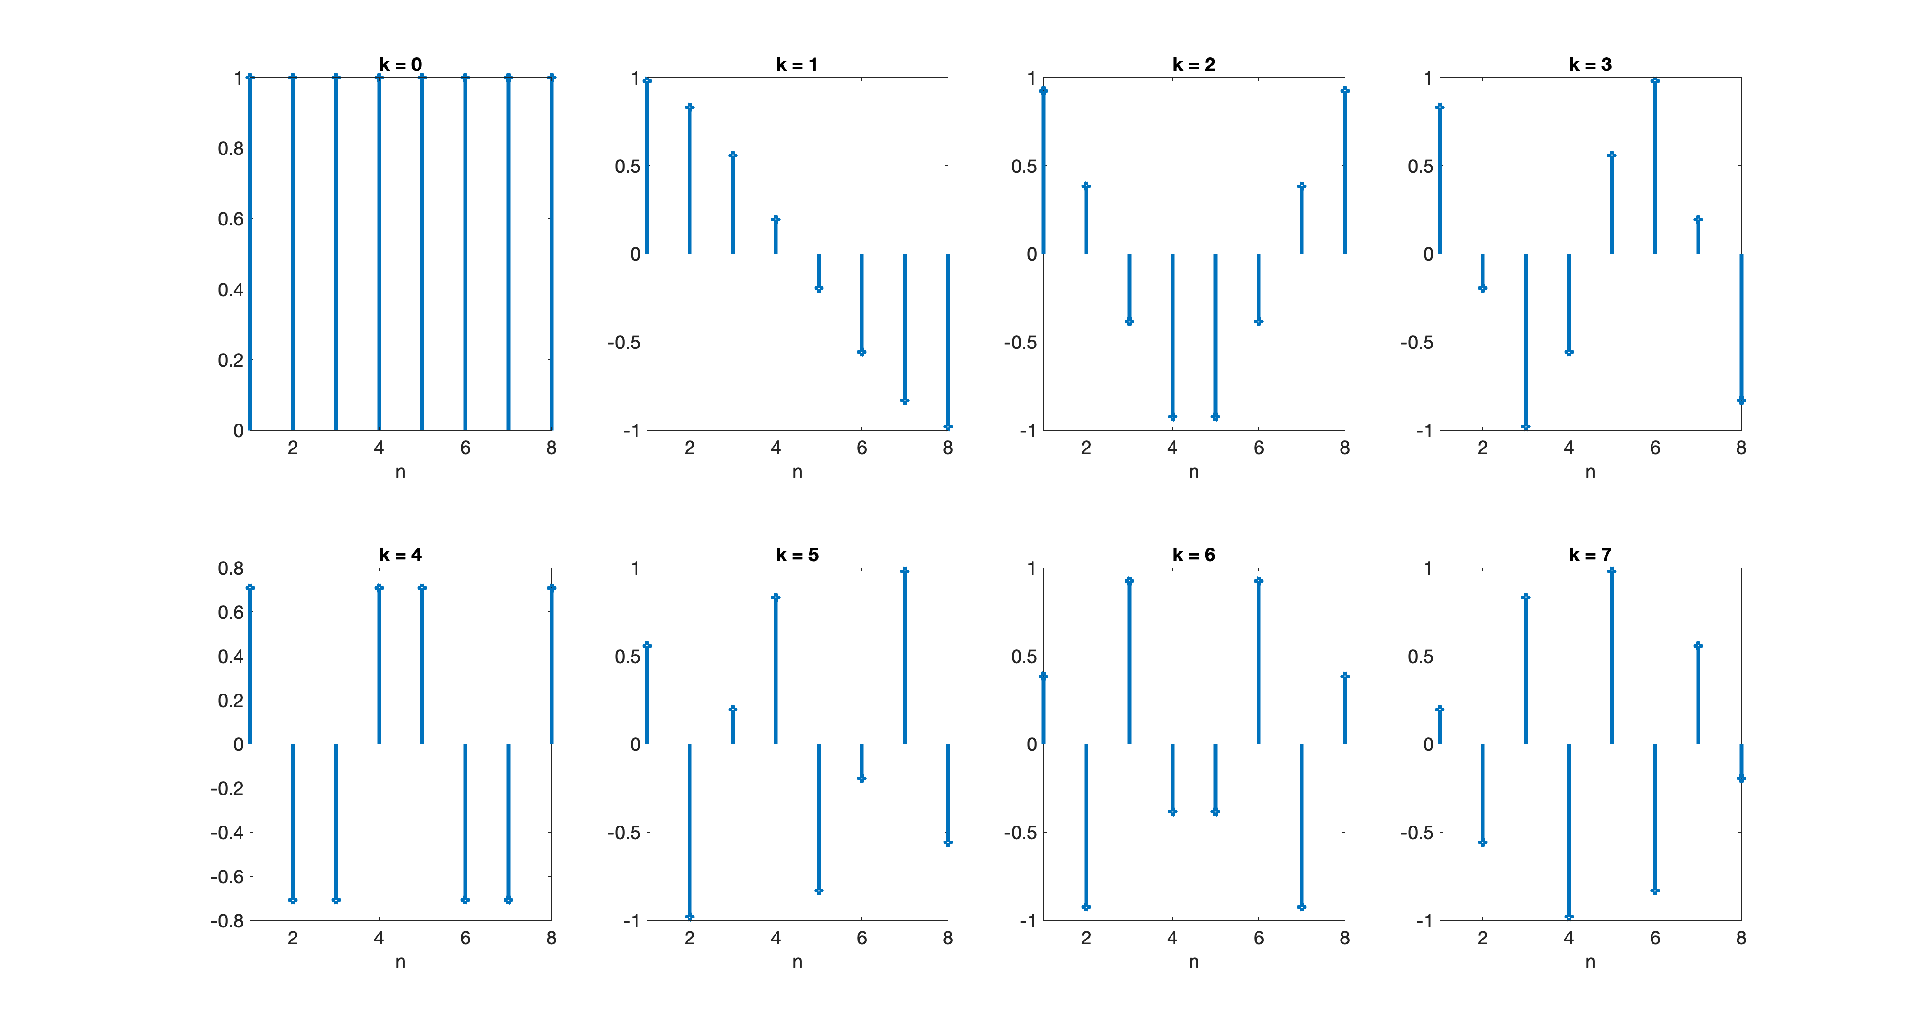
DCT – DC and AC components
the DCT is the average value of the sample sequence, this is called DC Coefficient, while all other transform coefficients are called AC Coefficients.
For N =8 and k [0,7]
Cosine Basis Functions

Slide 10
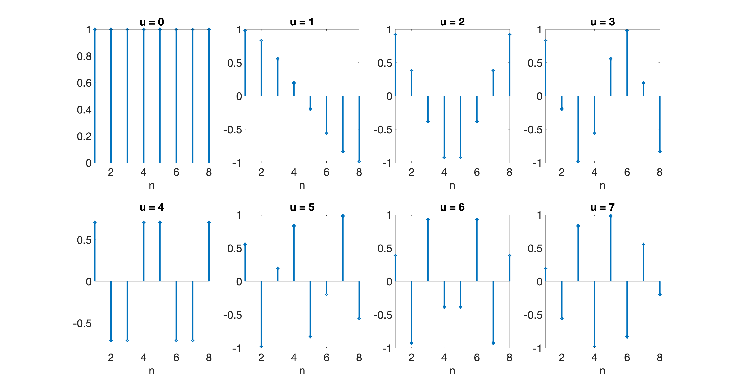
DCT – Cosine Basis Functions
Cosine Basis Functions are orthogonal, meaning that the sum over all the samples of the products between any two different waveforms is 0.
While the sum in case of product of the waveform with itself leads to a constant value.
Orthogonal functions are independent, meaning that none of the basis functions can be represented as combination of the other basis functions.

Slide 11
DCT – Computational Consideration
What if my sequence has an arbitrary length L greater than N ?
sequence
0 | 1 | 2 | … |  |  |  |  | L
CBF
0 | 1 | 2 | … | N
0 | 1 | 2 | … | N
0 | 1 | 2 | … | N
Thanks to the independence of the Cosine basis function it is possible to divide the sequence in sub-sequences of length N.
This means that the cosine basis functions can be pre-computed and stored making the DCT computation very computationally efficient.

Slide 12
2D DCT
A natural extension of the DCT is to the 2D case – from sequences to images
And the inverse 2D DCT

Slide 13
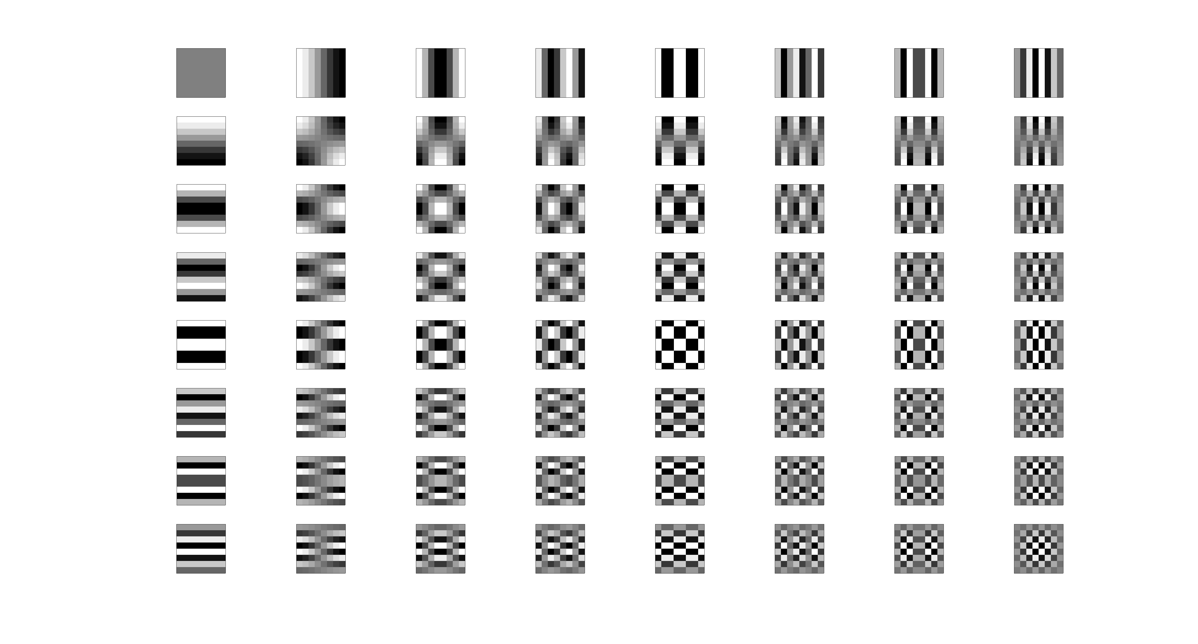
2D DCT Basis functions
The 2D DCT Basis Functions are obtained by multiplying the column 1D basis functions with the row 1D basis functions.

Slide 14
DCT - Properties
Decorrelation- outputs are decorrelated, thus reducing redundancy.
Energy Compaction – signals energy is compacted in a lower number of coefficients, thus allowing even lossless compression.

Slide 15
DCT - Properties
Separability – means that N-dimensional DCTs can be computed as sequence of 1D DCTs
The 2 D Case

Slide 16
DCT - Properties
Symmetry – the DCT is a symmetric transformation, and being also separable it can be expressed in the form:
Where A is a NxN symmetrical transformation matrix with elements;
This means that in its matrix form, the DCT can be computed very efficiently.
Orthogonality- easier to compute the inverse as

Slide 17
DCT – Uses – compression
The main Use of the DCT is for Data compression (i.e. JPEG), but it also found application in feature extraction for machine learning tasks.
To perform data compression it is sufficient to set to discard part of the coefficients, i.e. those relative to the higher frequencies and store/transmit only those remaining;
Inverse DCT of Child; (a) DCT(100%); (b) DCT(75%); (c) DCT(50%);(d) DCT(25%).

Slide 18
DCT – 1D example in Matlab
close all
N=8;
n=[0:1:N-1];
k=[0:1:N-1];
whos
basis_1df=cos((2*n+1)'*k*pi/(2*N))
basis_1df=basis_1df*sqrt(2/N);
basis_1df(:,1)=basis_1df(:,1)/sqrt(2);
figure
for i=1:N
subplot(8,1,i)
stem(n,basis_1df(:,i))
End
% signal generation
sig_exp=0.8.^n;
sig=sig_exp.*cos(pi*n/4)
figure
stem(n,sig)
title('plot of discrete signal (0.8)^n cos(pi n/4) ')
xlabel('discrete time index')
ylabel('amplitude level’)
grid
figure
dct_coeff=basis_1df'*sig’ % compute 8 point DCT
stem(k,dct_coeff)
title('plot of DCT coefficients ')
xlabel('DCT coefficient index')
ylabel('amplitude level')
grid
% output numerical values for display
sig
basis_1df=basis_1df'
dct_coeff=dct_coeff’
% compute inverse DCT
x_idct=basis_1df'*dct_coeff'
x_idct=x_idct'
% compute dct and IDCT using Matlab functions
xdct_matlab=dct(sig);
xidct_matlab=idct(xdct_matlab);
% compression example
% zero coefficients 4,5,6,7,and 8 and reconstruct the signal
dct_compress=dct_coeff .* [1 1 1 0 0 0 0 0 ];
x_recon=basis_1df'*dct_compress';
x_recon=x_recon';
% Check effect of compression
figure ; grid
stem(n,sig, 'o')
hold
stem(n,x_recon,'*')
title('plot of o original and reconstructed * signals ')
xlabel('time index')
ylabel('amplitude level')

Slide 19
DCT – 1D example in Matlab
sig = 1.0000 0.5657 0.0000 -0.3620 -0.4096 -0.2317 -0.0000 0.1483
basis_1df =
0.3536 0.3536 0.3536 0.3536 0.3536 0.3536 0.3536 0.3536
0.4904 0.4157 0.2778 0.0975 -0.0975 -0.2778 -0.4157 -0.4904
0.4619 0.1913 -0.1913 -0.4619 -0.4619 -0.1913 0.1913 0.4619
0.4157 -0.0975 -0.4904 -0.2778 0.2778 0.4904 0.0975 -0.4157
0.3536 -0.3536 -0.3536 0.3536 0.3536 -0.3536 -0.3536 0.3536
0.2778 -0.4904 0.0975 0.4157 -0.4157 -0.0975 0.4904 -0.2778
0.1913 -0.4619 0.4619 -0.1913 -0.1913 0.4619 -0.4619 0.1913
0.0975 -0.2778 0.4157 -0.4904 0.4904 -0.4157 0.2778 -0.0975
dct_coeff = 0.2512 0.7219 1.0395 0.1721 0.0151 0.0016 -0.001 -0.0011
dct_compress = 0.2512 0.7219 1.0395 0 0 0 0 0
sig_rec = 0.9230 0.5878 0.0905 -0.3209 -0.4618 -0.3106 -0.0124 0.2150
x_idct = 1.0000 0.5657 0.0000 -0.3620 -0.4096 -0.2317 0.0000 0.1483

Slide 20
DCT – 1D example in Matlab

Slide 21
DCT – Summary
We have introduced the Discrete Cosine Transform and the Inverse Discrete Cosine Transform;
Its Definitions for 1D and N-D cases were introduced together with its Properties;
The DCT has been successfully applied for data compression and it was widely used in the last decades;
Even if it is now probably superseded by other techniques its simplicity makes it an ideal candidate for addressing compression and data representation tasks;
During MT and in the next tutorial you will be able to familiarize more with this technique.

Slide 22
X THE PLACE OF USEFUL LEARNING

